Slide 1
Lecture 6: BA at the Data Warehouse Level
Prof. Mike Boyle
Department of Operations and Information Systems
University of Utah

Slide 2
Lecture Outline
Terminology
DW Architecture
Why a DW?
DW Feasibility
DW Access and Usage
Why a Big Data DW Approach?

Slide 3
Terminology: Traditional DW
Data Warehouse
A collection of data to support decision-making processes
BI Portal/Server
Software that general provides features for end users (e.g. user interface for reporting and analysis) and administrators (e.g. security, performance tuning, etc.) of BI solutions.
DW Client Software
For Reporting and Analysis
E.g. Excel, Tableau, R, SAS
ETL Processes
Stands for Extract, Transform and Load. In general, moving data from source systems into the DW and moving data around within the DW involves ETL processes. These processes are typically implemented using an ETL software package (E.g. Pentaho Kettle, Microsoft SSIS)

Slide 4
Terminology: Traditional DW (cont’d)
Dimensional model
Data organized in such a way so as to provide effective and efficient support of analytic queries (as opposed to transactional queries).
OLAP
OnLine Analytical Processing (i.e. for analysis; has dimensional model)
Consider differences between OLAP and OLTP (i.e. for transaction processing; has relational data model)
Cube
Multi-dimensional dataset for analysis
Report
Presents data in context (i.e. information)
Can be automated or ad hoc

Slide 5
Terminology: Big Data and the DW
Enterprise Data Hub
Modern term for hadoop-based data warehouse including an Exploratory Area and a Traditional Area
Exploratory Area
Detailed, unprocessed data and processing power are expediently made available to advanced users (i.e. Data Scientists, Engineers and Senior Analysts) for their use for various tasks
Traditional Area
Cleaned, highly-organized (i.e. in summary tables and dimensional models) data are made available for analysis by a relatively less advanced group of users through common BI tools
Hadoop
HDFS
The Hadoop Distributed File System (HDFS) is designed to provide a fault-tolerant file system designed to run on commodity hardware*
Map Reduce
A programming model and an associated implementation for processing and generating large data sets with a parallel, distributed algorithm on a cluster*
* source: wikipedia.org, accessed 2014/10/01
** source: cloudera.com, accessed 2014/10/01

Slide 6
Terminology: Big Data and the DW (cont’d)
ETL/Query/Workflow
Hive
A data warehouse infrastructure built on top of Hadoop for providing data summarization, query, and analysis*
Initially developed by Facebook
Pig
a high-level procedural language platform developed to simplify querying large data sets in Apache Hadoop and MapReduce*
Initially developed by Yahoo
Impala
the industry's leading massively parallel processing (MPP) SQL query engine that runs natively in Apache Hadoop**
supports interactive querying (as compare to batch querying from Hive)
Sqoop
a command-line interface application for transferring data between relational databases and Hadoop*
Flume
Provides support for importing stream-based data sources (e.g. log files)
Oozie
a workflow scheduler system to manage Hadoop jobs*
* source: wikipedia.org, accessed 2014/10/01
** source: cloudera.com, accessed 2014/10/01

Slide 7
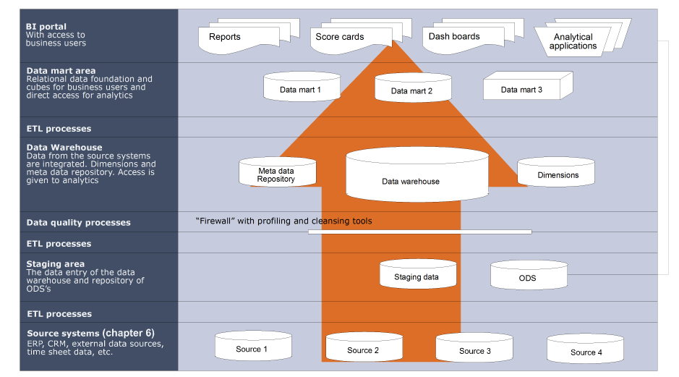
DW Architecture: Perspective from Text

Slide 8
DW Architecture: Traditional DW Perspective
Source Systems
Data Warehouse
End User Data Analysis
Data Staging Area
Data Mart #1: based on a single business process or operated by a single department
Feed
Ad Hoc Query Tools
Transform:
Clean; Combine; Remove duplicates; Transform
Databases
Extract
Report Writers
Load
Feed
Conformed dimensions and facts
Feed
End User Applications
Flat files
Extract
Data Mart #2
Models: forecasting; optimizing; data mining; etc.
Web
services
Conformed dimensions and facts
Extract
Feed
Data Mart #3

Slide 9
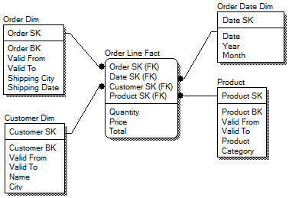
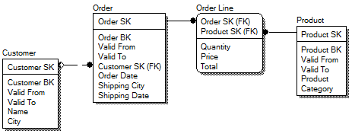
DW Architecture: Dimensional vs. Relational Modeling
Dimensional
Model
Key concept:
Dimensional data models support analytic tasks (i.e. queries)
Relational data models support transaction processing tasks
Relational
Model
9

Slide 10

DW Architecture: Modern DW (i.e. Big Data) Perspective
Data Scientists / Analysts
Data Sources
Staging Area
Data Warehouse
BI Portal
Exploratory
Area
Traditional
Area
Processing and Storage
Business Users
Data Governance

Slide 11
Why a DW?
BA pillar: Information Management challenges
Concept: drowning in data, thirsty for knowledge
Data quality
E.g., solution: extract transform and load (ETL) process(es) can address some data quality issues
Query complexity
E.g., queries against transactional databases are generally more complex (i.e. take more time to write, run and have higher rates of errors) compared to those against DWs
Inconsistent data formats
E.g., customer has different formats across two (2) different operational systems
Data governance
E.g., who can see what data? how long are data stored?

Slide 12
Why a DW? (cont’d)
BA pillar: Analysis challenges
Concept: drowning in data, thirsty for knowledge (cont’d)
Data accessibility
E.g., need to put in a data request to an engineer or specialized analyst and wait
Query performance
E.g. need data returned at the “speed of thought” to support a natural human analytical process
Data overload
E.g., solution: provide view of only what is needed for given analytical process
Ability to segment
E.g., need ability to “slice and dice” data to support human analytical sub-process of analysis through comparison

Slide 13
Why a DW? (cont’d)
BA pillar: Culture/Leadership challenges
Concept: Imperative to become relatively more data-driven in decision-making due to competitive pressure
E.g., did the VP for Marketing decide on the advertising budgets for branches in the SW region based on their sales performances over the last five years? Or based on some other criteria?
A recent study of corporations across a variety of geographies and industries (LaValle et al 2011) concluded that “top-performing organizations are twice as likely to apply analytics to activities.”*
*LaValle et al, “Big Data, Analytics and the Path From Insights to Value” MIT Sloan Management Review (2011)

Slide 14
DW Feasibility: Analysis
Guides organization in determining whether to proceed with a DW project
Identifies the project risks that should be addressed if the project is approved
Major components:
Technical feasibility
Economic feasibility
Organizational feasibility

Slide 15
DW Feasibility: Technical
Main question: Can we build it?
Sources of risk (some, not all):
Low familiarity
Domain
E.g., a Customer DW requires developers familiar with marketing terms and processes
Technology
E.g., Cutting edge/new technology vs. familiar technology
Large projects sizes
Complex integrations with existing systems

Slide 16
DW Feasibility: Economic
Main question: Should we build it?
Costs:
Development costs are one-time
Annual operating costs are on-going
Benefits:
Tangible benefits
E.g. cost savings, revenue increases
Intangible benefits
Difficult to measure in $ amount (e.g. people are relatively more data-driven and therefore making better decisions)

Slide 17
DW Feasibility: Organizational
Main question: If we build it, will they come?
Is the DW project aligned with our business strategy?
E.g., Customer DW for Marriott
E.g., Inventory management DW for Amazon
Stakeholders
Is there senior management support? (critical success factor #1)
Is there user engagement? (critical success factor #2)
Is there a project champion? What is their role?

Slide 18
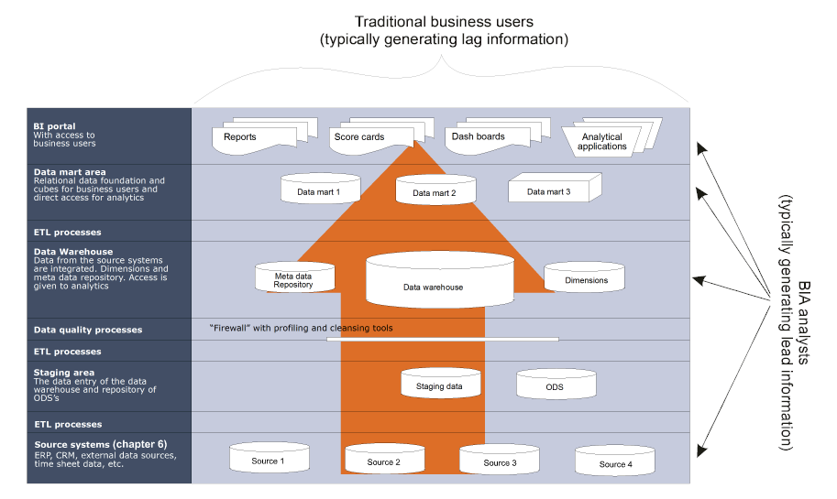
DW Access and Usage: Traditional DW

Slide 19
DW Access and Usage: Modern DW (i.e. Big Data)
Data Scientists / Analysts
Data Sources
Staging Area
Data Warehouse
BI Portal
Exploratory
Area
Traditional
Area
Processing and Storage
Business Users
Data Governance

Slide 20
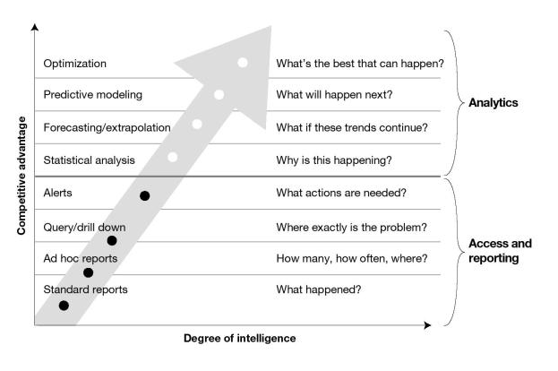
DW Access and Usage: Support of Features and Projects
DW provides indirect support
DW provides direct support
Davenport, T. H., Harris, J. G. 2007. “Competing on Analytics: The new science of winning,” Harvard Business School Press.

Slide 21
Why a Big Data DW Approach?

Slide 22
Motivation: Challenges with Traditional DW
New data types being captured and mined (often rapidly) to create competitive advantages
Unstructured/semi-structured
Links/networks
Images/Videos
Sensor/Geolocation data
Social streams
Traditional DW development processes and technologies (i.e. RDBMSs) cannot handle new data types:
Fast enough
Cost effectively
Hadoop-based systems can handle the new data types

Slide 23
Modern Data Warehouse Architecture (MDWA)
Data Scientists / Analysts
Data Sources
Staging Area
Data Warehouse
BI Portal
Exploratory
Area
Traditional
Area
Processing and Storage
Business Users
Data Governance

Slide 24
MDWA: Data Sources
Internal sources:
Data are relatively more structured and have relatively few sources (i.e. low variety):
Internally supported systems
E.g. eCommerce Website, CRM, custom application, etc.
Unstructured/semi-structured data available
E.g. company email, text from wikis, images, sensors, devices, etc.
Relatively low volume of data
Velocity of data creation and movement relatively low
External sources:
Data are relatively less structured and there are relatively many sources (i.e. high variety)
Text from public websites, social streams, images, sensors, devices, APIs, feeds
Structured data available
Partners’ systems
E.g. Web Analytics data from Adobe Analytics
Purchased data
Relatively high volume of data
Velocity of data creation and movement relatively high

Slide 25
MDWA: Data Sources (cont’d)
Big Data technologies…
Traditional DW technologies…
…designed to manage the complexity involved with many of the external data sources
…designed to manage the level of complexity involved with the majority of the internal data sources
DW practitioners have likely pushed relational database technologies beyond their practical effectiveness

Slide 26
MDWA: Staging Area
Similar objectives compared to traditional DW Staging Area, but:
Big Data technologies create opportunities for doing ETL:
Faster
More cost effectively. Consider:
Development
Maintenance
Storage
Processing
Downtime
Many traditional ETL tools have Big Data

Slide 27
MDWA: Staging Area (cont’d)
Similar objectives compared to traditional DW Staging Area, but:
Big Data technologies drive down the cost of storage such that:
More data sources can captured and maintained in the “hot” storage environment
More granular data can be captured per source
Unprocessed (“fatty”) data can be captured for future processing

Slide 28
MDWA: Data Warehouse
Traditional Area
Exploratory Area
Interactive “Business Users”
Months of relatively narrow, aggregated data
Development and maintenance follows a software engineering process
Relatively low degree of unplanned data duplication
Relatively high cost platform
Relatively high operational overhead (helpdesk support, service levels, etc.)
Data scientists and experienced analysts
Years of broad, disaggregated (i.e. detailed) and/or unprocessed data
Development/addition of data follows demand of analytics projects
Relatively high degree of unplanned data duplication
Low cost components make up the platform
Relatively low operational overhead

Slide 29
MDWA: BI Portal
Traditional Area
Exploratory Area
High degree of curated data objects in DW made accessible through BI Portal
Varying degree of curated data objects in DW made accessible through BI Portal
More likely to publish pre-processed, curated data objects from the Exploratory Area to the Traditional Area to be made accessible through BI Portal

Slide 30
MDWA: Users
Traditional Area
Exploratory Area
Through BI Portal
Business users
Entry level analysts
Data Scientists and experienced analysts
Direct access
Data Scientists and experienced analysts
Data Scientists and experienced analysts

Slide 31
MDWA: Storage and Processing
Traditional Area
Exploratory Area
Higher cost
Centralized
E.g. DW Appliances
Lower cost
Distributed
E.g. Commodity hardware

Slide 32
MDWA: Governance
Traditional Area
Exploratory Area
Relatively high levels of governance in place
More likely to be built into the software development process that is used
Developed by team, not by individual data scientists dumping data into environment to support an analytics project
Relatively low levels of governance in place
Risk for some of the data
Tradeoff for efficiency in analytics project

Slide 33
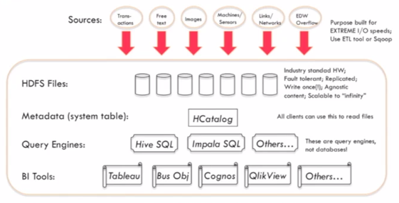
Example: Hadoop for Exploratory Area
Source: “Building a Hadoop Data Warehouse”, Ralph Kimball, http://vimeo.com/90798133, accessed 2014/07/16

Slide 34
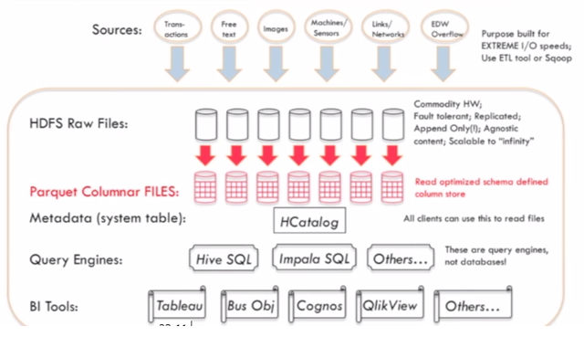
Example: Hadoop for Traditional Area
Source: “Building a Hadoop Data Warehouse”, Ralph Kimball, http://vimeo.com/90798133, accessed 2014/07/16

Slide 35
Example: Hadoop and the Data Hub
Data Scientists use Impala, Hive, Pig, Mahout, Spark MLLib, custom code, etc.
Data Hub (HDFS, Pig, Hive, Hbase)
Streaming Data Sources
Staging Area
Data Scientists / Analysts
Flume
BI Portal
Exploratory
Area
ETL
Database Sources
Sqoop
Traditional
Area #1
ETL
Business Users
EDW
ETL in the Data Hub use Hadoop components (e.g. Hive, Pig, Avro, Parquet, Oozie, Sqoop, Flume)
Sqoop
Traditional
Area #2
Backups/archiving not needed for data that enters the Data Hub

Slide 36
Why a Big Data DW Approach?
Managing new data types
Supporting new types of analyses in a common “coding” environment
Supporting “schema on read” for exploratory analysis
Keep hyper granular “active archive” forever
Supporting “Enterprise Data Hub” concept
Lowering operational costs
Linear scaling: response time, concurrency and data size (i.e. cost)
In memory processing
Highly reliable, write-once, redundantly stored data
Effective for meeting ETL service level agreements
Source: “Building a Hadoop Data Warehouse”, Ralph Kimball, http://vimeo.com/90798133, accessed 2014/07/16

Slide 37
Why a Big Data DW Approach? (cont’d)
“It’s Not That Difficult”
Existing DW/BI tools work with Hadoop, e.g.:
ETL Tools
BI Portals/Query Tools
Basic skills are common to many IT organizations:
Java, Python, Ruby, Perl
SQL
Linux
Development
System administration
Source: “Building a Hadoop Data Warehouse”, Ralph Kimball, http://vimeo.com/90798133, accessed 2014/07/16

Slide 38
DW Course at DESB
IS 6480 – Data Warehousing

Slide 39
Appendix

